Slide 1
ORGANIZATIONAL BEHAVIOR

Slide 2
Organisational Behaviour
A field of study that investigates the impact that individuals, groups, structures have on behaviour within organisations for the purpose of applying such knowledge towards improving an organisations’ effectiveness.

Slide 3
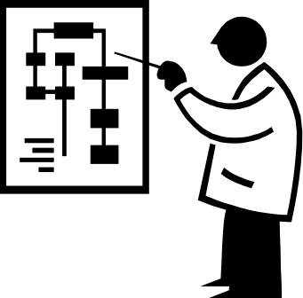
Challenges and Opportunity for OB
Responding to Globalization
  Increased foreign assignments
  Working with people of Different cultures
  Coping with anti capitalism backlash
Managing Workforce Diversity
  Age, gender, race, ethnicity, sexual orientation
  Implications: don’t treat everybody alike – recognise the differences
Improving Quality and Productivity
  Excess capacity = increased competition = steps to lower costs and improve quality & productivity = process re-engineering (requires extensive employee involvement)‏

Slide 4
Challenges and Opportunity for OB
Responding to the Labor Shortage
Improving Customer Service
  Majority of people today are in the service industries.
  US (80%), Australia (73%), Japan (65%), ...
  Management need to ensure that employees do what it takes to please the customer.

Slide 5

Challenges and Opportunity for OB (cont’d)‏
Improving People Skills
  Interpersonal, personal effectiveness
Empowering People
  More employees given full control of their work
  More self managed teams
  Implications: employees learn how to take responsibility and make decisions while learn how to give up control
  Implications : changes in styles of leadership, work design, organisational structures

Slide 6
Challenges and Opportunity for OB (cont’d)‏
Coping with “Temporariness”
  Fast and flexible organisations = temporary workforce
  Implications: workers need to continually update their knowledge and skills
  Changing work assignments
  Learn to live with temporariness, flexibility, spontaneity, unpredictability
  OB’s Assist = help employees cope with change and respond positively to change.

Slide 7
Challenges and Opportunity for OB (cont’d)‏
Helping Employees Balance Work/Life Conflicts
  Common complaint: line between life and work getting blurred = conflicts and stress
  Factors responsible:
    Globalisation = world never sleeps
    Communication technology
    Longer working hours
    Trend: double earning couple
  OB challenge: provide the balance

Slide 8
Challenges and Opportunity for OB (cont’d)‏
Improving Ethical Behavior
  Pressure to perform can lead to ‘cutting corners’ or using ‘questionable practices’
  What to do when employees know the company is practising unethical activities?
  Excuses : ‘everyone does it’ : ‘you have to do it to win’
  Result: Few know the difference between ‘right’ and ‘wrong’.
  decrease in trust and confidence in others
  Code of ethics, seminars, workshops

Slide 9
Vault Inc. Survey
Workers admitting to pilfering office supplies = 67%
Pens and pencils = 60%
Post its = 40%
Envelopes = 32%
Note pads = 28%
Paper = 27.5%
Paper clips = 26%
Highlighters = 24%
Office chairs, keyboards, modems, software and computer monitors = 3%
Late 70's : Popular New Year's Gift : “The Ethics of Wall Street” - It had an imposing cover and an Impressive title page.
Bottomline: Customers return when they know they can trust you.

Slide 10
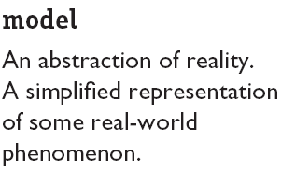
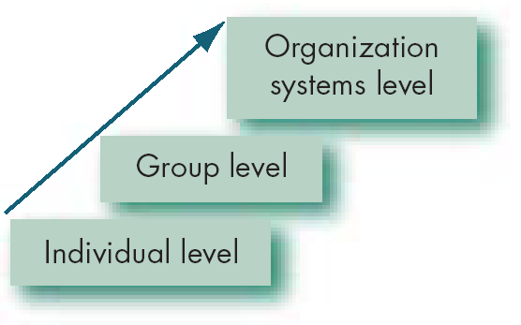
Basic OB Model, Stage I
Each Level is like a building block. Each level is constructed on the previous level.

Slide 11
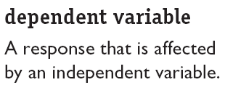
The Dependent Variables
y
x
Dependent variables in OB:
Productivity
Absenteeism
Turnover
Job satisfaction
Deviant workplace behaviour
Organisational citizenship bahaviour

Slide 12
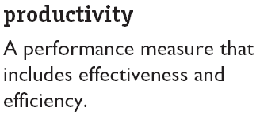


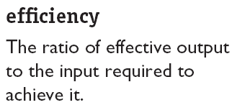
The Dependent Variables (cont’d)‏
An employees’ attitude and behaviour can affect productivity
Question: what factors will influence the effectiveness and efficiency of individuals?

Slide 13
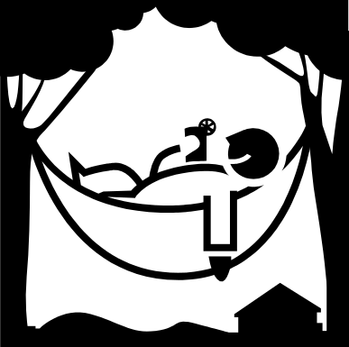


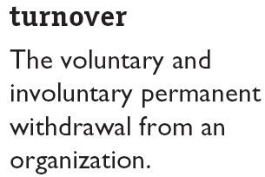
The Dependent Variables (cont’d)‏

Slide 14
The Dependent Variables (cont’d)‏
Deviant workplace behaviour
‘antisocial behaviour’ or ‘workplace incivility’
Loud music
Irritating co-workers
Insulting a colleague
Steal
Gossip excessively
Engage in sabotage
Result of DWB = chaotic workplace
Cause? Could be dissatisfaction

Slide 15
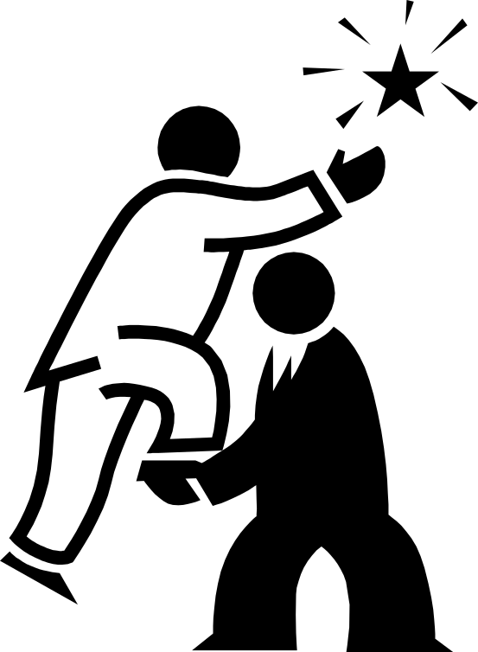
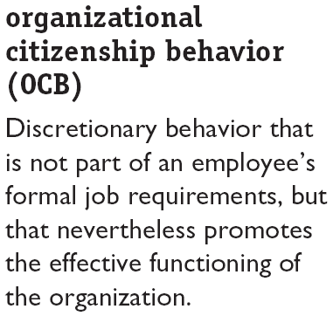
The Dependent Variables (cont’d)‏
Helping others, volunteer extra work, avoiding unnecessary conflicts, respecting the spirit and letter of rules and regulations, graciously tolerate work related nuisance

Slide 16
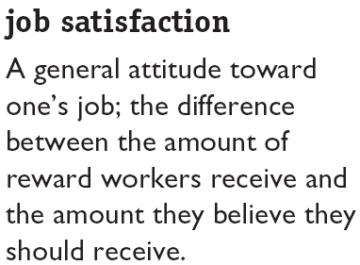

The Dependent Variables (cont’d)‏

Slide 17
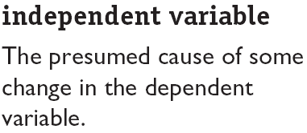
The Independent Variables
Independent
Variables
Individual-Level Variables
Group-Level
Variables
Organization
System-Level
Variables

Slide 18
Systems Level
HR policies & practice
Organisation structure & design
Organisational culture
Group Level
Group decision making
Leadership & trust
Conflict
Power & politics
Communication
Group structure
Individual Level
Biographical characteristics
Personality & emotions
Values and attitudes
Perception
Individual decision making
motivation
Productivity
Absenteeism
Turnover
Deviant work behaviour
Job satisfaction
Organisational citizenship behaviour

Slide 19
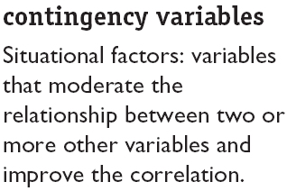
There Are Few Absolutes in OB
Contingency
Variables
x
y

Slide 20
Frederick W Taylor (1856 – 1917)‏
Pricipal object of management
  To secure maximum prosperity for employer and employee
Management and workforce are inter-dependent
Workmen are capable of hard work, good will and ingenuity
Proposed 4 underlying principles of management:
  Need to develop a ‘science of work’
  Workers to be ‘scientifically’ selected and developed
  Combine first two to get best results
  Divide work and responsibility equally between workers and management

Slide 21
Alfred P Sloan (1875 – 1966)‏
Joined General motors in 1917, became president in 1923
Rejected centralisation of power
Looked more to Henri Fayol’s functional approach
Developed systematic strategy planning and managerial accountability

Slide 22
Elton Mayo (1880 – 1949)‏
Influential in ‘Hawthorne experiments’ (Western Electric Co., USA, 1927-32)‏
  Large scale experiments (20,000 employees)‏
  Work satisfaction and hence performance is basically not economic
  Rejected ‘Taylorism’ and its emphasis on employee self-interest
  The influence of ‘peer group’ is very high
  Denounced ‘rabble hypothesis’ that society is a horde of unorganised individuals concerned with self preservation and self-interest

